Slide 1

ISOM671
Amazon Book Recommendations
From Book Review
Group 17: Songbo Hu, Jayson Xu, Silvia Lee, Zhuhang Jiang, Leonidas Mugema

Slide 2
Introduction
Publishing
Companies
Business Value
General trend: shorter attention span and a lack of reading for Gen Z
Analyze the Amazon book review dataset to discover why certain books are more popular
Use the insights from the previous step to develop a personalized book recommendation system to increase book sales for businesses and stimulate reading interest in the upcoming generation
Users:
enhance user engagement,
personalize reader experiences
Companies:
higher book sales from focusing demanded books in the market

Slide 3


Data Storing, Ingestion, and Processing
Storing
Ingestion
Processing
AWS Tools:
S3
Considered Sqoop
HDFS < Apache Spark ecosystem < Jupyter Hub (considered Hue too) + PySpark
Pro | Con
Why | Why not?
 | Customers don’t leave review or make decision based on the most recent one review. No need for real-time process like fraud credit card detector. This also explains why we are using HDFS over Hbase
Pro | Con
Interactive Speed for big data User Friendly (python, SQL, etc..) | Complex Setup Limited Pandas Compatibility
Able to store big data
Cost-Effectiveness
Latency, Take time to load
Security
Obtaining and importing data for immediate use or storage

Slide 4
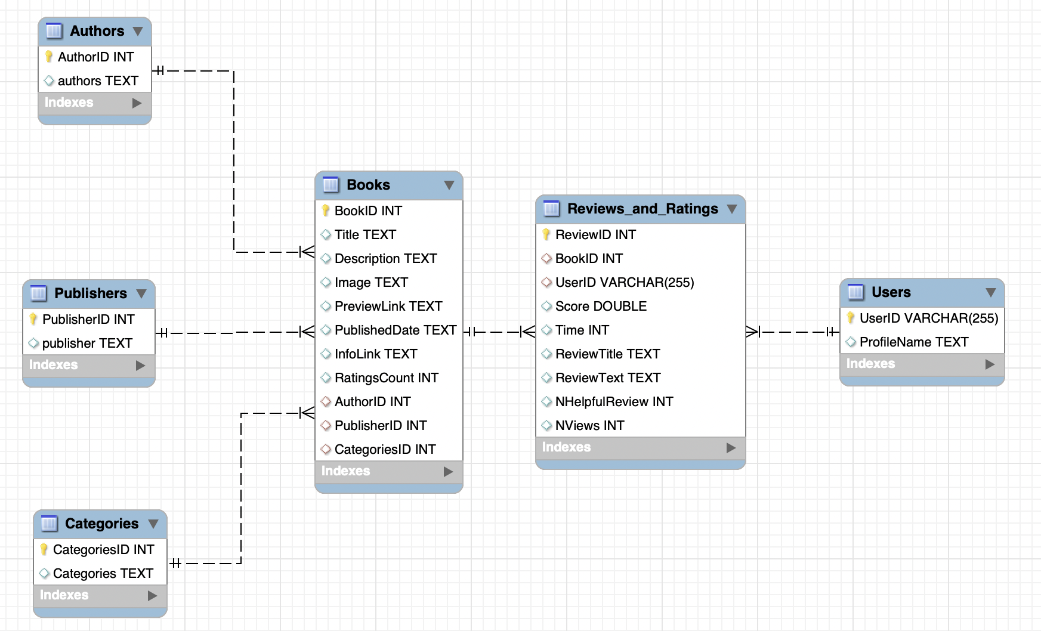
ER Model
6 normalized relational tables
Notes:
The original datasets from Kaggle contain 2 tables: books data and books review. In order to satisfy 3NF, we created auto increment primary keys for the authors, publishers, categories, and the reviews table, and we partitioned them into 6 smaller tables with primary and foreign keys constraints.

Slide 5
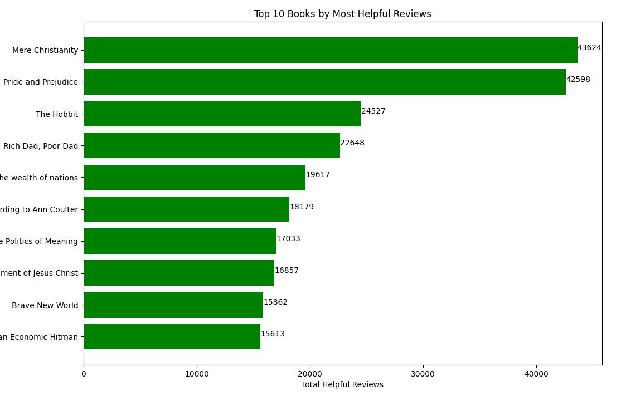
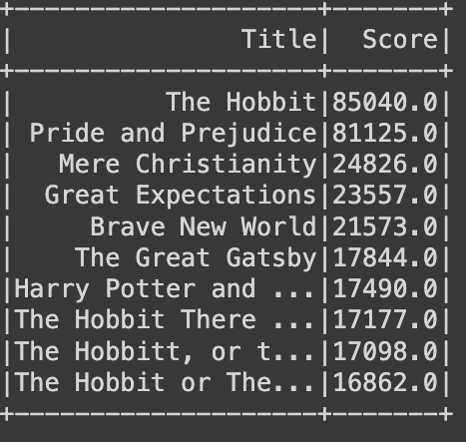
Insights
Insight:
Value:
Top 10 books by the number of helpful reviews and especially shows ‘Mere Christianity’ and ‘Pride and Prejudice’ doubling the most helpful reviews than the rest. Both graphs have the same top 3 books. The market is in high demand with ‘Mere Christianity’, ‘Pride and Prejudice’, and ‘The Hobbit’. This insight aligns with Top 10 Authors by Total Score and Total Number of Helpful Reviews because the author of Hobbit is in Top 10 authors
Top 10 Books by the number of helpful reviews
Publishing companies can reduce the costs of running the sentimental model only focusing on the fact that people will most likely recommend these helpful 10 books to other customers, which leads to more traffic to these book sales.
Top 10 Books by the total scores

Slide 6
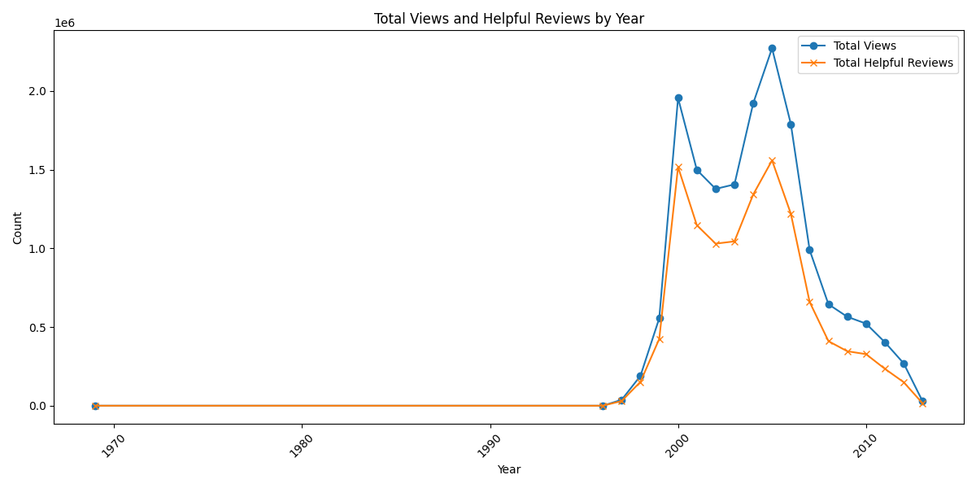
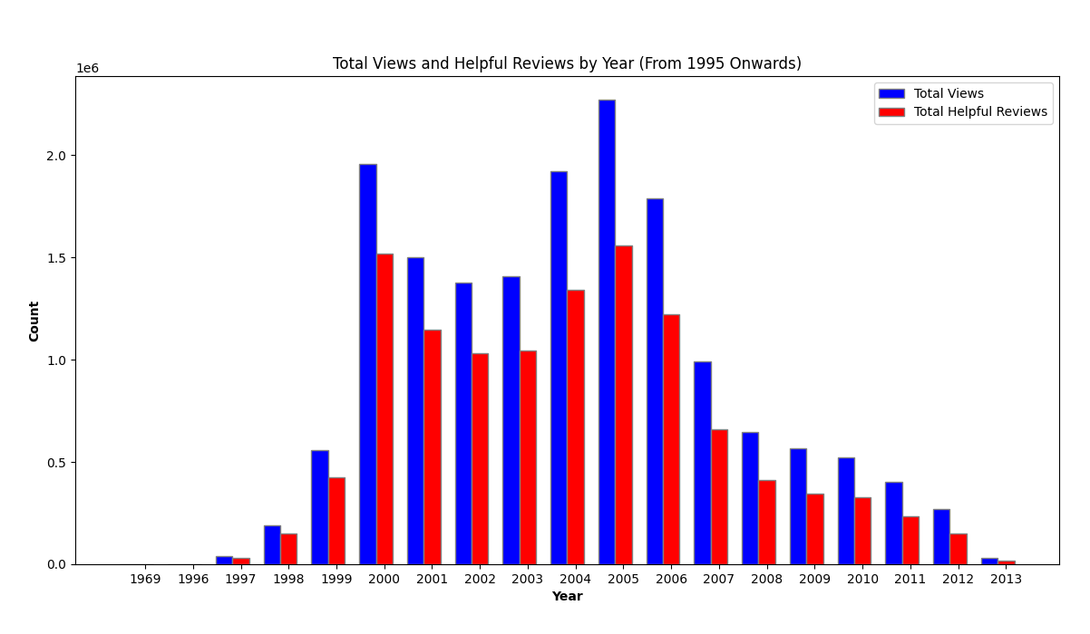
Insights
Insight:
Value:
2000-2016 had the most book reviews followed by total helpful reviews.
Publishing companies can focus on running the sentimental analysis for reviews between 2000-2016 to analyze why people left the most reviews - maybe it was the boom of digital media during that time, or maybe the media led to people trying to engage in online communities such as online book clubs, etc.
Total Reviews & Helpful Reviews from 1970-2013
Notes:
Another insight is a market trend. When we have queried total number of reviews and total number of helpful reviews from 1970 to 2013, we see a huge incline and decline around 2000-2016, this shows that publishing companies can focus on running the sentimental analysis for book reviews between that time period in order to analyze why people left the most reviews. Again, this can reduce the labor cost of running the model but also the company can now drill into the insight by speculating if it was the boom of media during 2000-2016 that cause the trend or the media leading people to engage in online book clubs during that time and more.

Slide 7
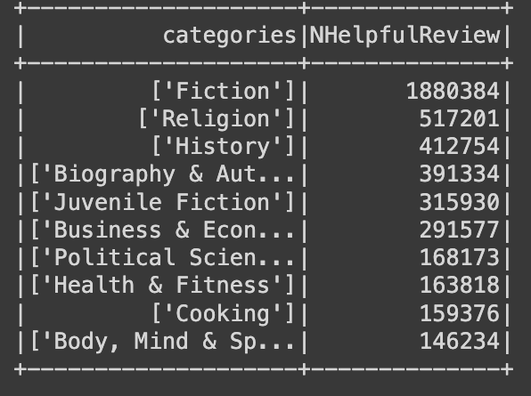
Insights
Insight:
Value:
Shows top 10 categories by total number of helpful reviews with fiction, religion, history, etc being listed in descending order. Fiction’s helpful review count is doubled the other categories. This insight aligns with top 10 Authors by Total Number of helpful Reviews with the top few author writing fictions
When the company is running the sentimental analysis, it can focus on analyzing reviews for categories such as ‘fiction’, ‘religion’, ‘history’, and more to gain insight into why people think these categories are helpful, as well as will build a better recommendation system for users seeking for books with a specific reason.
Top 10 Categories by Total Number of Helpful Reviews
Notes:
Our third insight revolves around categories, specifically top 10 categories by total number of helpful reviews. We can see that the top 10 categories by total number of helpful reviews are fiction, religion to body and mind and spirit.
1 things to note are: Fiction’s helpful review count is doubled the other categories. This insight aligns with top 10 Authors by Total Number of helpful Reviews with the top few author writing fictions.
When the company is running the sentimental analysis, it can focus on analyzing reviews for top 10 categories because it will give value on why people think these categories are helpful, thus it will contribute a more helpful recommendation system for users seeking for certain books for a certain reason.

Slide 8
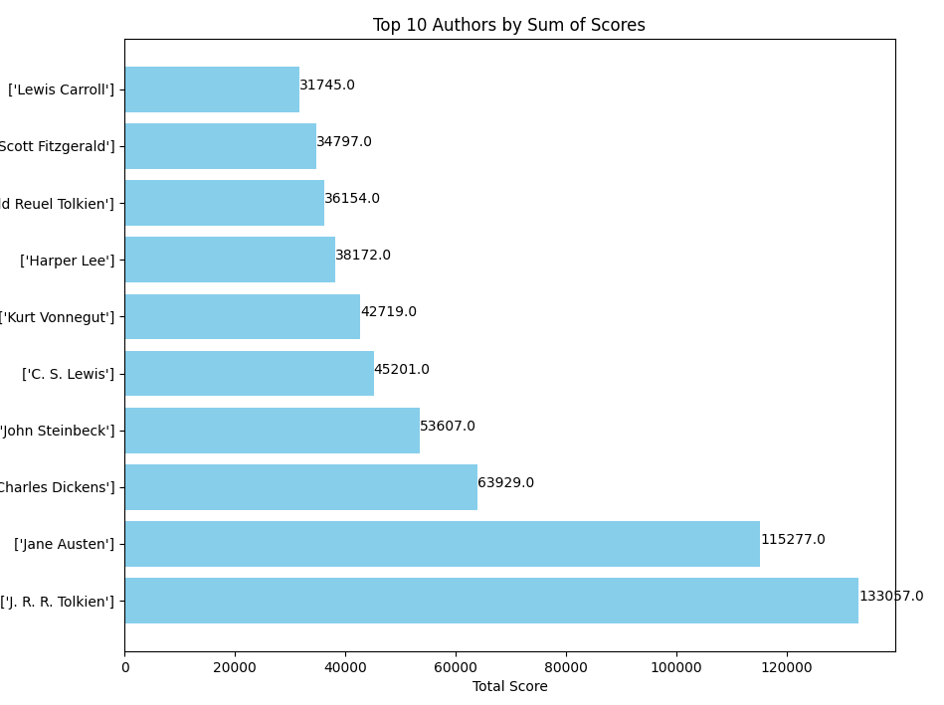
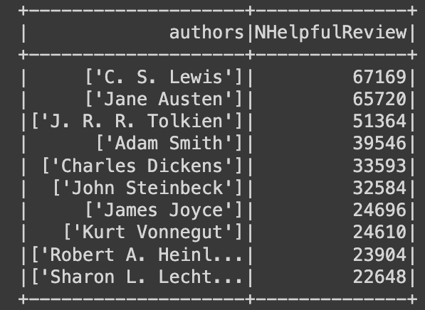
Insights
Insight:
Value:
Shows top 10 categories by total number of helpful reviews with fiction, religion, history, etc being listed in descending order. Fiction’s helpful review count is doubled the other categories. This insight aligns with top 10 Categories by Total Number of helpful Reviews with the top few author writing top 10 categories such as fictions.
Top 10 Authors by Total Score
Focus on doing sentimental analysis for reviews for authors such as ‘J. R. R. Tolkien’, ‘Jane Austen’, ‘Charles Dickens’, ‘C.S. Lewis’, and more to analyze
If people think these reviews are helpful due to the authors’ name alone or other reasons but the author’s name was just mentioned in the review.
This would help the publishing company to build an accurate recommendation system for users seeking certain books for a particular reason.
Top 10 Authors by Total Number of Helpful Reviews

Slide 9
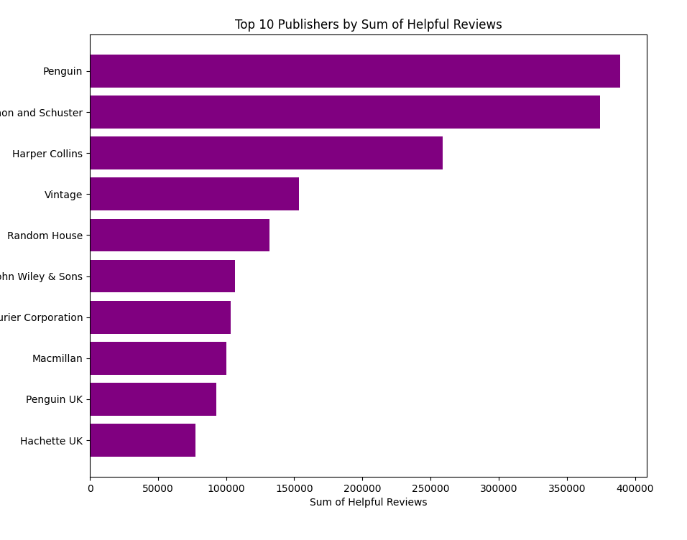
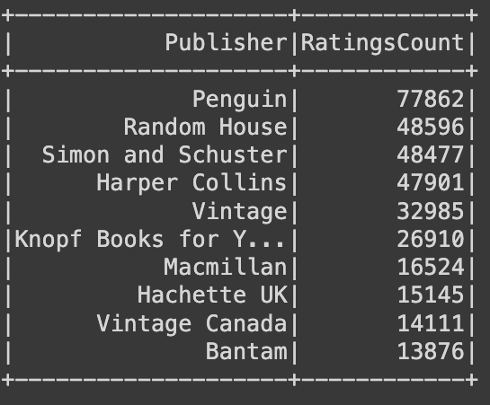
Insights
Insight:
Top 10 publishers by the total number of helpful reviews, count or ratings, and and especially shows ‘Mere Christianity’ and ‘Pride and Prejudice’ doubling the most helpful reviews than the rest.
Value:
Top 10 Publishers by Total Number of Helpful Reviews
When the company is running the sentimental analysis, it can focus on analyzing reviews for publishers such as ‘Penguin, ‘Random House’, and more to analyze a pattern of why these customers think this book from this publisher is most helpful. This would help our client, a publishing company, to follow the business strategies of ‘Penguin, ‘Random House’, and more to ensure higher book sales long term in the market
Top 10 Publishers by Total Number of Ratings

Slide 10
Thanks!
Do you have any questions?

